Slide 1
Composite Design Pattern
The composite pattern is used to structure objects in a tree-like hierarchy. Here, each node of the tree can be composed of either child node(s) or be a leaf (no children objects).
This pattern allows the client to work with these components uniformly; that is, a single object can be treated exactly how a group of objects is treated.
Operating systems use the pattern which in turn led to useful features like allowing us to create directories inside other directories.
@ShankaragoudaG

Slide 2
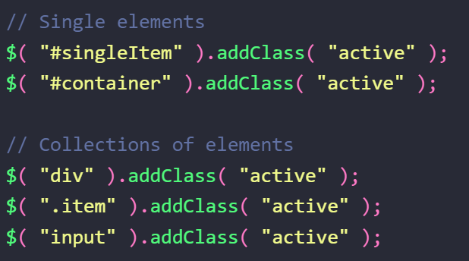
Composite Design Pattern
In jQuery, when we're applying methods to an element or collection of elements, we can treat both sets in a uniform manner as both selections return a jQuery object.
This is demonstrated by the code sample using the jQuery selector below.

Slide 3
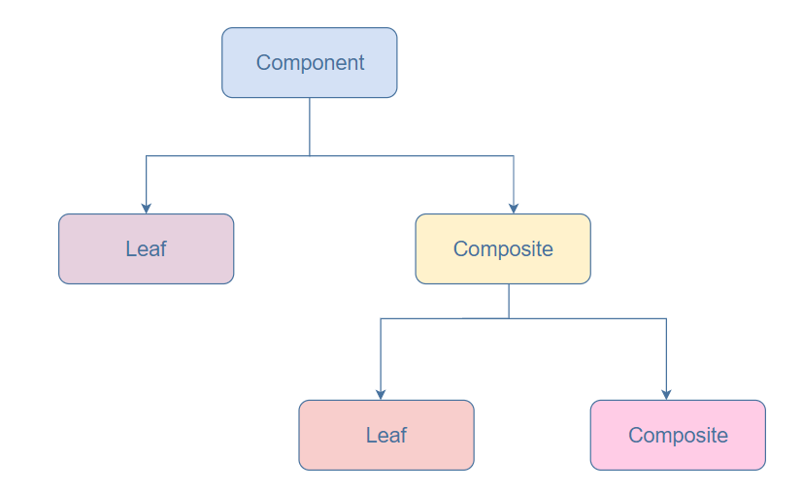
Diagram
Component:
declares the interface for objects in the composition
Leaf :
represents leaf objects in the composition. A leaf has no children
Composite :
represents branches (or subtrees) in the composition
maintains a collection of child components

Slide 4
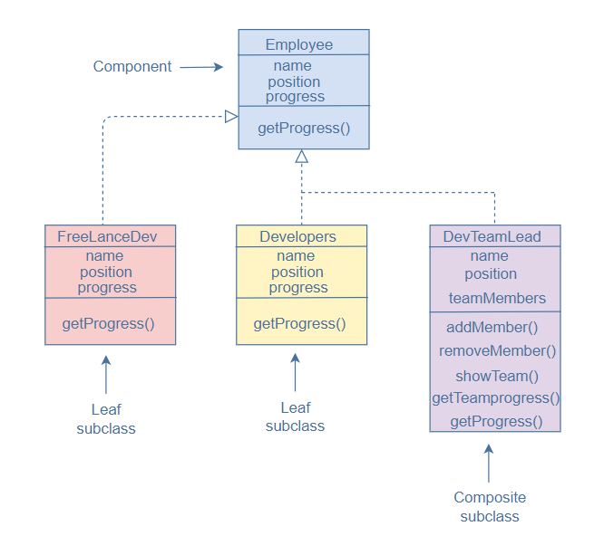
Example

Slide 5
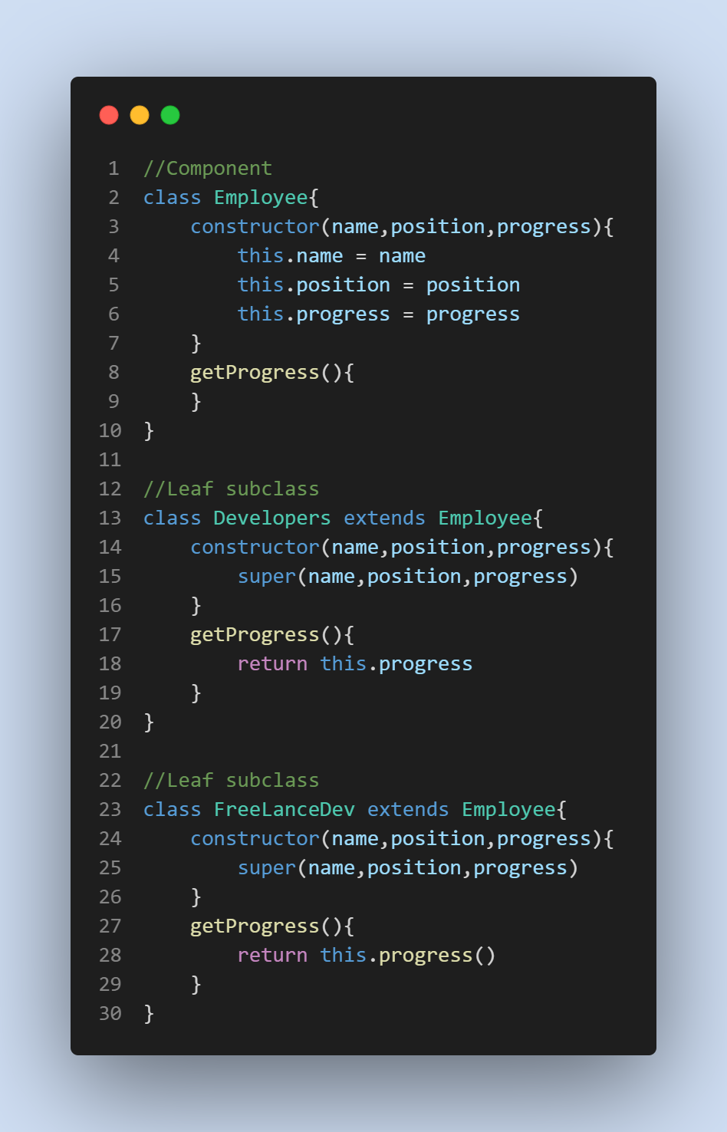
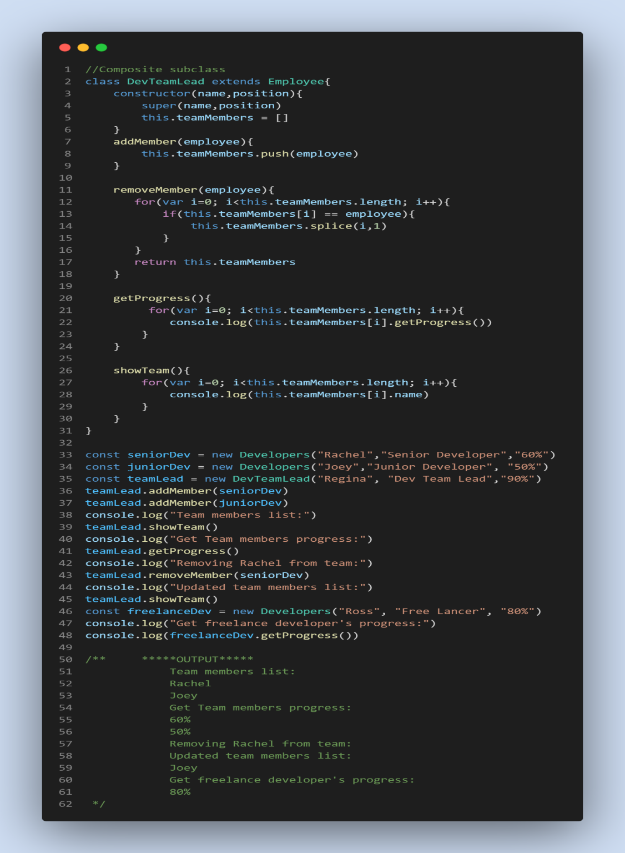

Slide 6
Useful Resources
https://www.educative.io/collection/page/5429798910296064/5725579815944192/6597912462098432
https://www.dofactory.com/javascript/design-patterns/composite
https://jsmanifest.com/the-composite-pattern-in-javascript/

